Slide 1
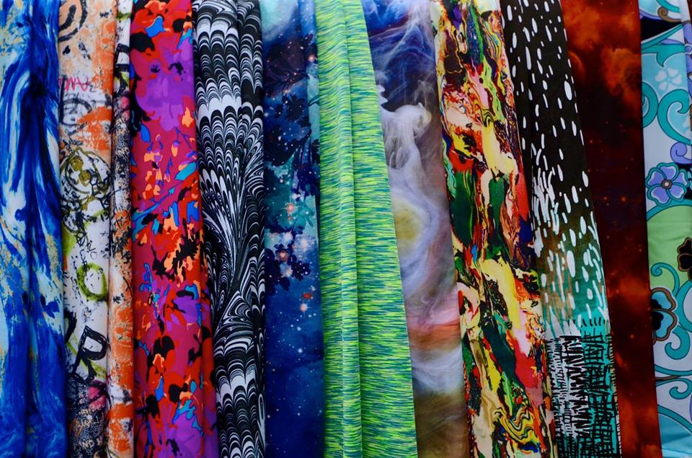
←make this cartwheel into the “L” when hover over it AND when load “Home” page
Nav 1 (Home / About / Blog / Gallery )
Nav 2 (Women’s / Men’s / How to Order)
P: “Legs by Liz Fundraiser for Camp Under the Woods”
Rounded box – low opacity
Button: “shop the collection”
rounded

Slide 2
H1: About
Nav (Home / Blog / Gallery / Women’s / Men’s / How to Order)
Content (History of “Legs by Liz”)
IMAGE
Content Continued (wrap text)
Content Continued (same box)
FOOTER – credits, C 2016 ( only show at bottom of content when scroll)

Slide 3
H1: Blog
Nav (Home / About/ Gallery / Women’s / Men’s / How to Order)
BLOG POST TITLE
BLOG POST DATE
BLOG POST CONTENT (Scrolls through keeping Nav on page)
Blog Nav
FOOTER (can only see this at end of post) Credits, C 2016

Slide 4
← Back Button
H1: Gallery
Scroll Through Photos with arrow on left and right (also on timed loop)
FOOTER Home / About/ Blog / Women’s / Men’s / How to Order)

Slide 5
H1: Women’s Styles Order Now >
Style Nav
- 3 boxes per row showing picture of product
Include short description
Option to view only that product on a different page close up
Order now link is on this page – brings you to “how to order” page
More description of style and fit
Size Guide Link
“Quick View” Option (pop up on screen, with faded screen behind)
When click on faded screen, revert out of quick view
Includes “order now” option –brings you to “how to order” page
When scroll through the “style Nave bar grows to fill full page as logo and Header1 disappear” --- footer always remains where it is
FOOTER Home / Men’s / About/ Blog / Gallery / How to Order)

Slide 6
H1: Men’s Styles Order Now >
Style Nav
- 3 boxes per row showing picture of product
Include short description
Option to view only that product on a different page close up
Order now link is on this page – brings you to “how to order” page
More description of style and fit
Size Guide Link
“Quick View” Option (pop up on screen, with faded screen behind)
When click on faded screen, revert out of quick view
Includes “order now” option –brings you to “how to order” page
When scroll through the “style Nave bar grows to fill full page as logo and Header1 disappear” --- footer always remains where it is
FOOTER Home / Women’s / About/ Blog / Gallery / How to Order)

Slide 7
H1: About
Nav (Home / About / Blog / Gallery / Women’s / Men’s )
H1: How To Order
Article: Complete Order Form to the Right →
P: Set Up Pay Pal Account
Link: (Click Here)
Article: Order Form (To be created…....)
Submit Request Button (how do I do this and have the request sent to an email)
Pay through paypal
FOOTER – credits, C 2016

